Slide 1

Project Title –Seasonal Agriculture Performance Analysis
Student Name – Diprajit Majumder
College Name - Holy Cross College, Agartala
AICTE STU ID : STU6a6359847f2981784895876

Slide 2

PROBLEM STATEMENT
Agricultural performance is influenced by seasonal variations in environmental conditions, farming practices, resource availability, and market conditions. Raw agricultural data doesn't clearly show how performance changes across seasons. This project analyzes seasonal agricultural data to identify meaningful patterns, trends, relationships, and variations in performance across the Kharif, Rabi, and Zaid seasons.

Slide 3
Project Description
This project analyzes a dataset of 4,000 farm records across 8 Indian states, 8 crops, and 3 seasons. The dataset includes environmental factors (rainfall, temperature, soil conditions), resource usage (fertilizer, water, irrigation method), and economic outcomes (cost, revenue, profit). Using Python (Pandas, Seaborn, SciPy), I cleaned the data, performed exploratory analysis, tested statistical significance across seasons using ANOVA, and identified key seasonal patterns to support data-driven agricultural planning.

Slide 4

WHO ARE THE END USERS?
Farmers, agricultural planners, government agriculture departments, agri-business analysts, and policy makers who need evidence-based insight into how seasonal conditions affect crop performance and profitability.

Slide 5

Technology Used
Python, Pandas, NumPy, Matplotlib, Seaborn, SciPy (statistics), Statsmodels (ANOVA/Tukey HSD), Google Colab, Jupyter Notebook.

Slide 6
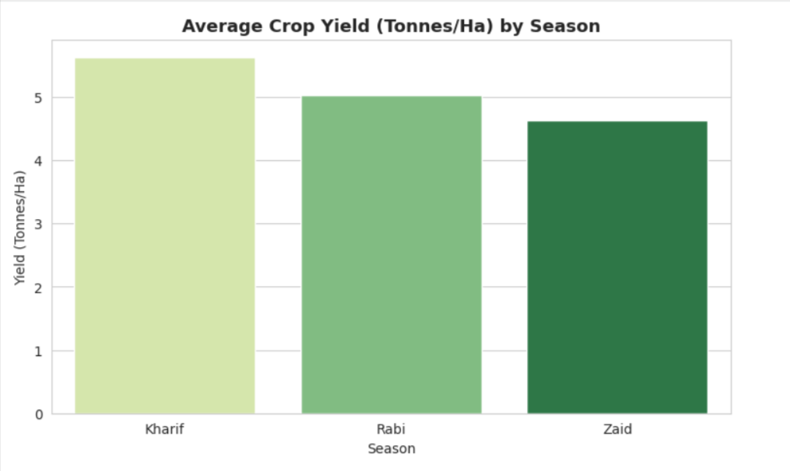
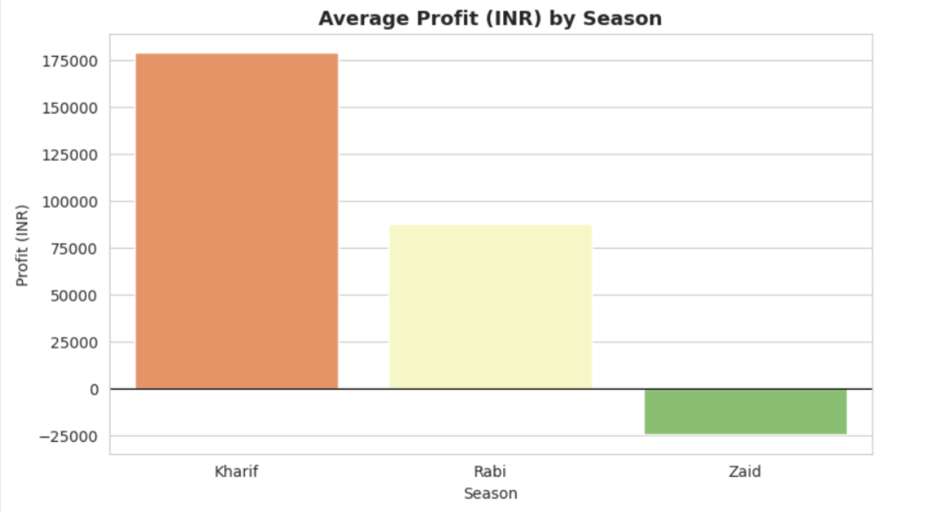
RESULT
Seasonal Yield & Profit Comparison
Kharif shows the highest average yield and profit among the three seasons, while Zaid shows the lowest profit despite reasonable yield — indicating performance clearly differs by season.

Slide 7
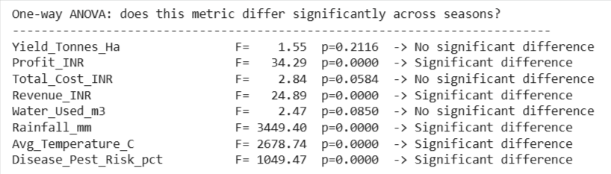
RESULT
Statistical significance testing
One-way ANOVA confirms that Profit, Revenue, Rainfall, Temperature, and Disease/Pest Risk differ significantly across seasons (p < 0.05). Interestingly, Yield itself does not differ significantly — showing that visual differences aren't always statistically meaningful, and vice versa.

Slide 8
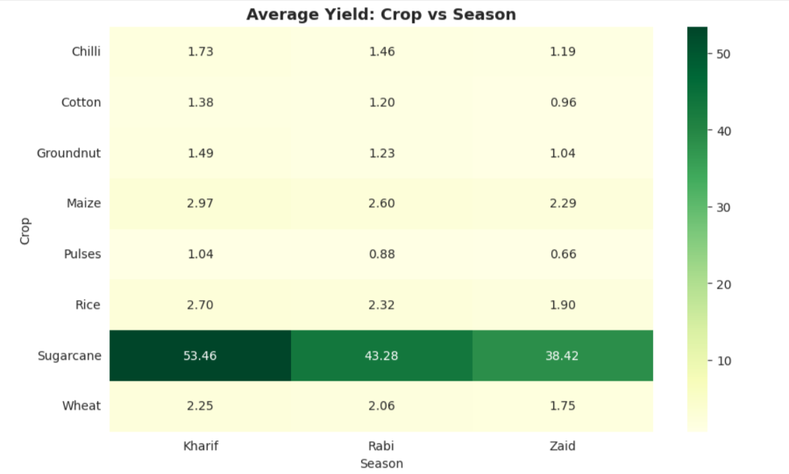
RESULT
Crop-wise performance within each season
This heatmap shows average yield (Tonnes/Hectare) for each crop across the three seasons. Two clear patterns emerge:
Sugarcane yields far more than any other crop — 53.46 t/ha in Kharif, dropping to 43.28 in Rabi and 38.42 in Zaid. Its scale is so much larger than other crops that it visually dominates the color scale.
Every single crop follows the same seasonal order: Kharif > Rabi > Zaid. For example, Maize goes from 2.97 → 2.60 → 2.29, and Rice goes from 2.70 → 2.32 → 1.90. This consistent decline across all 8 crops shows Kharif is the strongest-performing season overall, regardless of crop type.

Slide 9
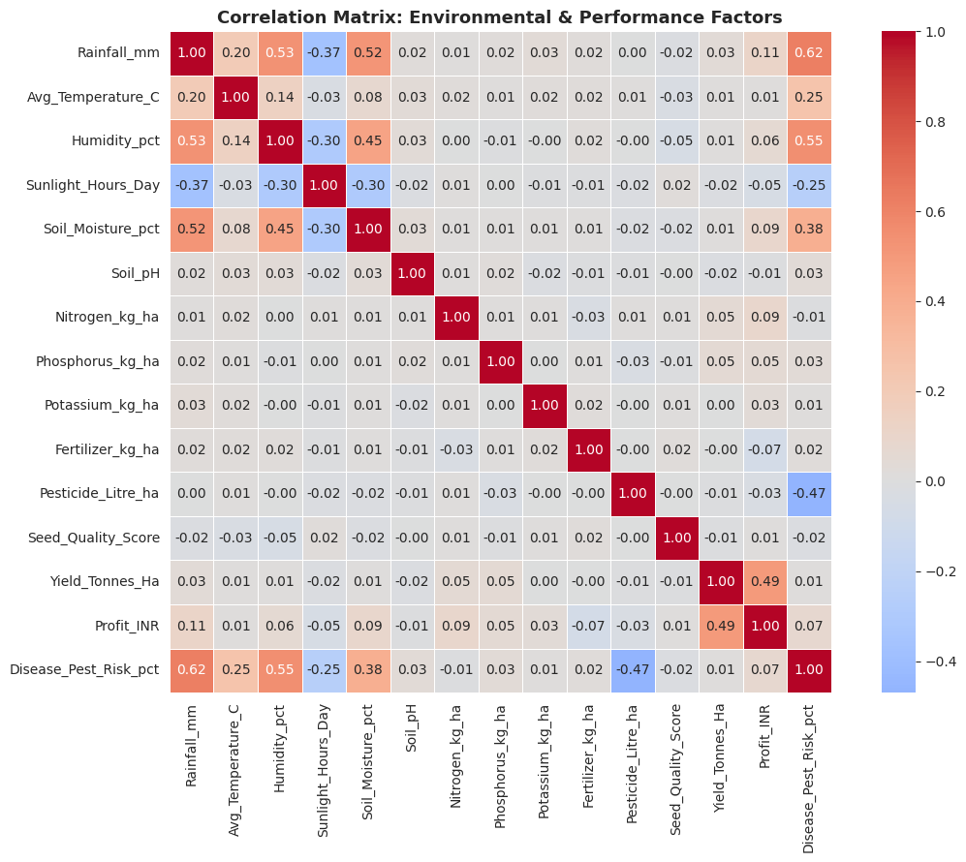
RESULT
Relationships between environmental conditions and yield
No single environmental factor strongly drives yield individually — all correlations are weak (under 0.05). This suggests yield outcomes depend on a combination of conditions rather than one dominant factor.

Slide 10
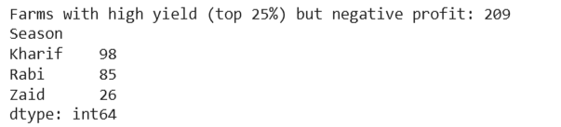
RESULT
Identifying unusual/unexpected patterns
209 farms had high yield (top 25%) but still recorded a loss, concentrated mostly in Kharif and Rabi. This shows that cost overruns — not poor farming — are the main driver of unprofitability in these cases.

Slide 11
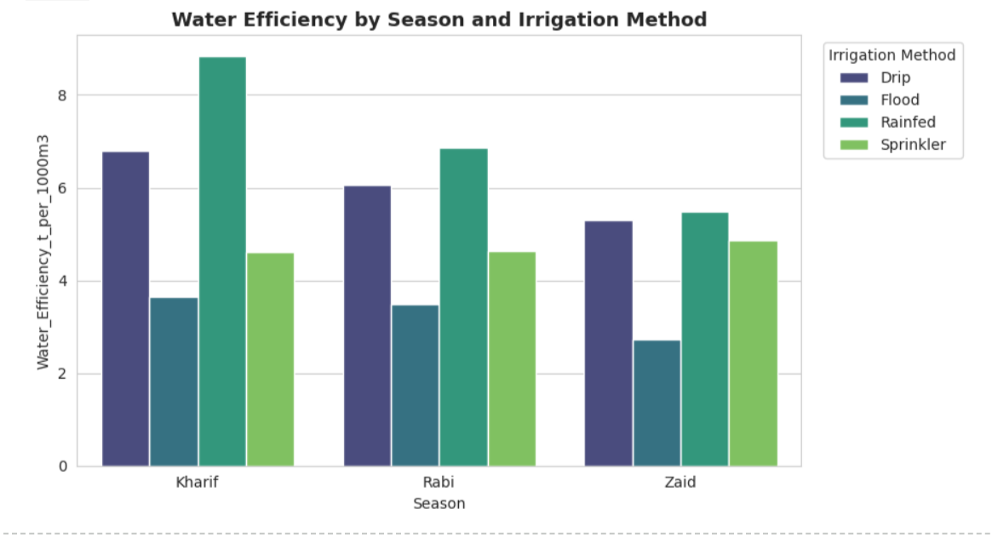
RESULT
Irrigation Method Effectiveness
Drip irrigation consistently gives the highest water efficiency across all three seasons (6.8 in Kharif, 6.0 in Rabi, 5.3 in Zaid tonnes per 1000m³) while using less total water than Flood irrigation. Flood irrigation is the least efficient in every season despite using the most water (up to 8,229 m³ in Kharif) — meaning it wastes the most water relative to yield produced. Rainfed farming, interestingly, is highly efficient in Kharif (8.8) since the season's natural rainfall does the work for free, but becomes the worst performer in Zaid (5.5) when rainfall is scarce. This is a strong, actionable finding: switching from Flood to Drip irrigation, especially in Zaid, would meaningfully improve water efficiency.

Slide 12
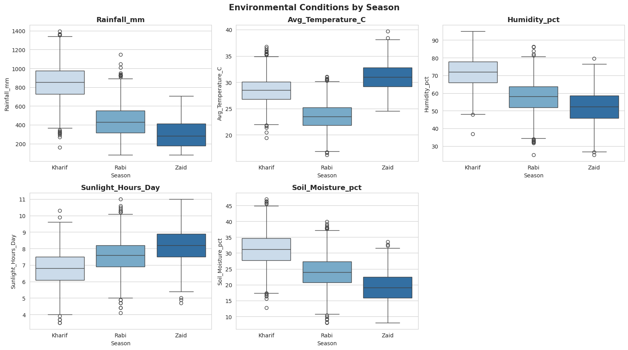
RESULT
Environmental Conditions Across Seasons
The three seasons show clearly distinct climate profiles. Kharif is the wettest and most humid season, averaging 852mm rainfall — nearly double Rabi (436mm) and almost triple Zaid (299mm). Zaid is the hottest (31°C avg) and driest, with the highest sunlight hours (8.2 hrs/day) but the lowest soil moisture (19%). Rabi sits in between on most metrics — cooler (23.5°C) with moderate rainfall. This explains why yield and profit consistently decline from Kharif → Rabi → Zaid: crops in Zaid face heat stress and low soil moisture despite plenty of sunlight.

Slide 13
Future scope
Future work could include predictive modeling (e.g. yield or profit prediction using regression), integrating real-time weather data, expanding to more regions, and building a dashboard for farmers to get season-specific recommendations.

Slide 14
GitHub Link
https://github.com/DiprajitMajumder/Seasonal_Agricultural_Performance_-Analysis.git

Slide 15

VOIS Course completion certificate - Course name- Data Visualization

Slide 16
Thank you
.
.

